Slide 1
MySQL HeatWave
Cloud Specialist Team
taewan.kim@oracle.com
June, 2021

Slide 2
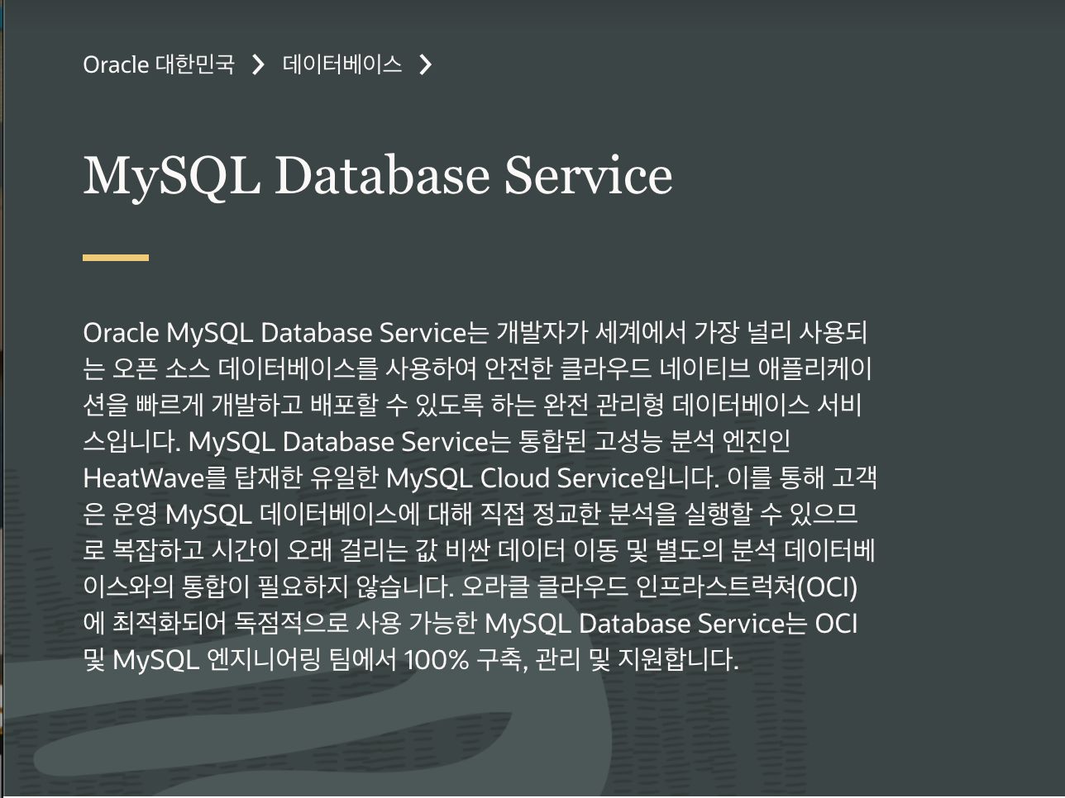
MySQL & HeatWave
https://www.oracle.com/kr/mysql/

Slide 3
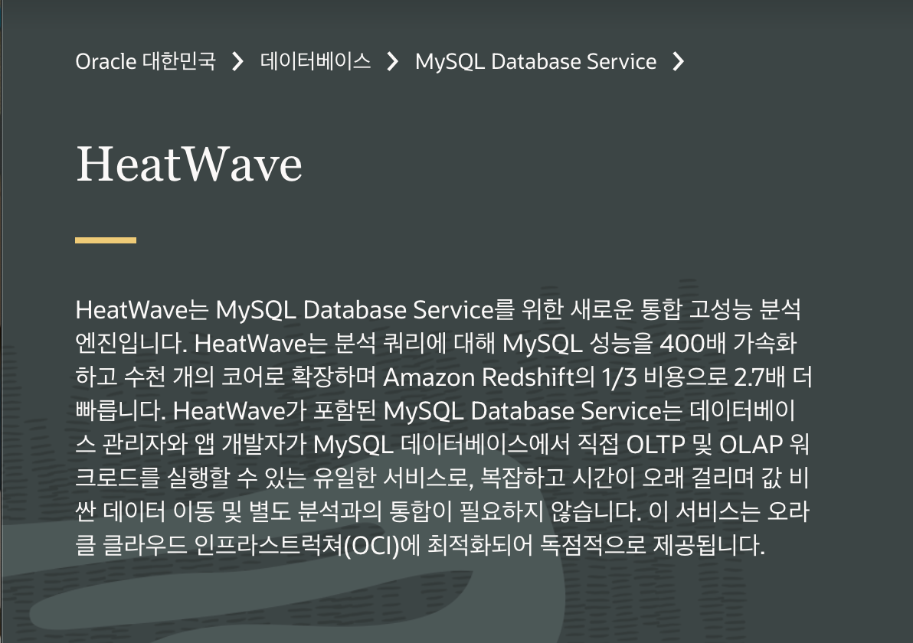
MySQL & HeatWave
https://www.oracle.com/kr/mysql/
https://www.oracle.com/kr/mysql/heatwave/

Slide 4
MySQL & HeatWave
https://www.oracle.com/kr/mysql/
https://www.oracle.com/kr/mysql/heatwave/

Slide 5
OCI MDS 가격 비교 Comparison US$ per Month (PAYG)
 | MySQL Database Service | AWS RDS MySQL | Azure MySQL | Google CloudSQL MySQL
Standard memory per Physical core/month | $41.37 Standard.E3 AMD Rome (8GB/core) | +208% $127.22 M5 Intel (8GB/core) | +217% $ 130.94 General Purpose Intel (10GB/core) | +160% $ 107.58 N1-standard Intel (7.5GB/core)
High memory per Physical core/month | $54.46 Standard.E3 AMD Rome (16GB/core) | +228% $ 178.56 R5 Intel (16GB/core) | +224% $ 176.33 Memory Optimized Intel (20GB/core) | +157% $ 140.17 N1-highmem Intel (13GB/core)
Storage (Data) per GB/month | 0.040 | +188% 0.115 General Purpose (SSD) Storage | +188% 0.115 General Purpose/Memory Optimized Storage | +325% 0.170 SSD provisioned
Backup per GB/month | 0.040 (with free quota) | +138% 0.095 (with free quota) | +150% 0.100 (with free quota) | +100% 0.080 (no free quota)
Notes:
이것은 MySQL Database Service의 단가를 비슷한 스펙으로 비교한것을 보여주는 것인데요.
1core당 8G의 표준 메모리 뿐만아니라 High memory로 비교했을 때도 200% 이상 저렴하구요
스토리지도 100%넘게 200%가까이 차이가 나고 Google Cloud같은 경우는 심지어 325% 차이가 납니다.

Slide 6

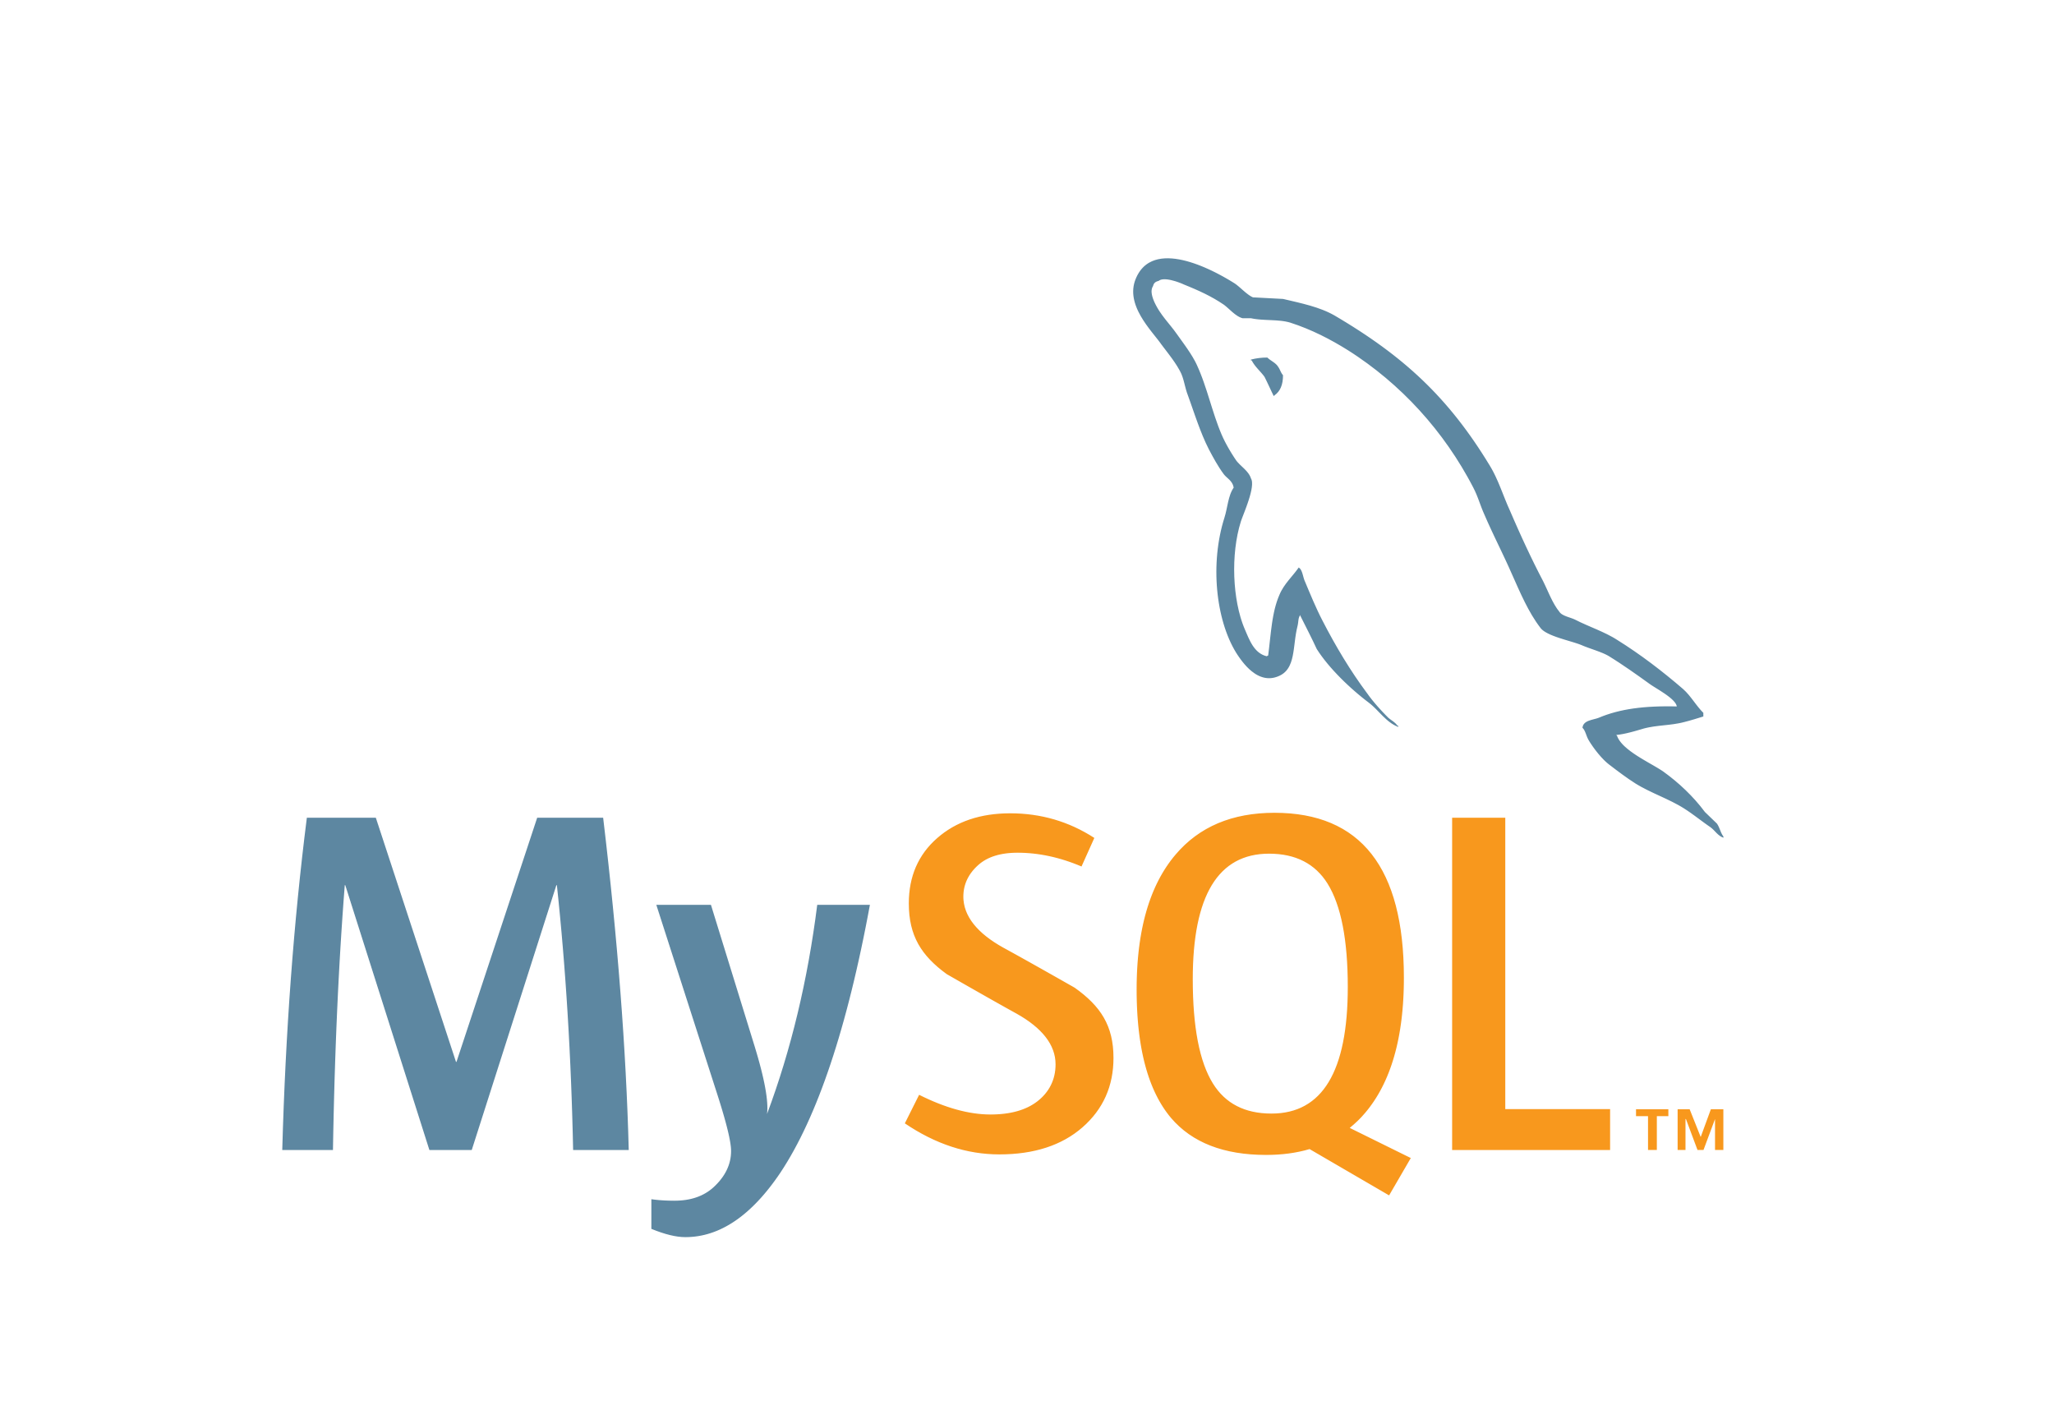
MySQL은 Web/Game에 특화된 데이터베이스
OLTP DB
OLTP에 최적화
Big Query 급격한 성능 저하
OLTP Applications
(Online Transaction Processing)
작은 데이터 입출력 위주 애플리케이션
6
Copyright © 2020, Oracle and/or its affiliates. All rights reserved.

Slide 7
MySQL은 Web/Game에 특화된 데이터베이스
OLTP DB
OLTP에 최적화
Big Query 급격한 성능 저하
OLTP Applications
(Online Transaction Processing)
작은 데이터 입출력 위주 애플리케이션
ETL (데이터 이관)
OLAP DB
OLAP Applications
(Online Analytical Processing)
대용량 데이터 처리 및 대용량 쿼리를 사용하는 데이터 분석 애플리케이션
7
Copyright © 2020, Oracle and/or its affiliates. All rights reserved.

Slide 8
HeatWave: MySQl 네이티브 고성능 인-메모리 분석
OLAP 쿼리
(대용량 데이터 쿼리)
대용량 분석 쿼리가 MySQL에 요청되면 MySQL 옵티마이저는 분석 쿼리를 구분하고 HeatWave에 실시간 처리 요청, HeatWave는 인-메모리에 데이터 로딩하여 고성능 데이처 처리하고 결과 반환
쿼리 결과 반환
MySQL Database Service
HeatWave
MySQL 컴파일러 & 옵티미아저
분석 잡 스케줄러
쿼리
Pushdown
OLTP 쿼리
옵티마이저
분석 쿼리
옵티마이터
분석 쿼리 실행
MySQL Execution
인-메모리 리프리젠테이션
Results
처리 결과를 MySQL에 반환
여러 Compute로 구성된
인-메모리 처리 MySQL 서버
8
Copyright © 2020, Oracle and/or its affiliates. All rights reserved.
Notes:
The MySQL optimizer has been enhanced to support analytics. The parser is unaltered. Hence the existing MySQL syntax works as is. The acceleration (query pushdown) is transparent to the application.

Slide 9







OCI MySQL Database 서비스는 완전한 대용량 데이터 분석 환경입니다.
HeatWave로 강화된 OCI MDS로 OLAP 애플리케이션과 분석 환경(BI)을 구성할 수 있습니다.
OLTP Applications
Oracle MySQL Service
OLAP
BI & Analytics
자동화, 실시간
데이터 관리
Social
ECommerce
FinTech
MySQL
Database Service
쿼리
가속기
(HeatWave)
SaaS
Copyright © 2020, Oracle and/or its affiliates. All rights reserved.
Notes:
Change arrows to be bi-directional – fix box and service
Add logos of products including OAC
Add on to MDS server,100% compatible with standard MySQL syntax – all existing tools and applications work
Native MySQL
100x Faster Performance
Real-time Analytics
Eliminates ETL
Unified Solution for OLTP & OLAP in MySQL
GA 3 December 1st, 2020

Slide 10
MySQL + HeatWave vs. Amazon Aurora
4TB
쿼리 처리 속도
년간 발생 비용 비교
데이터 로딩 시간 비교
TPC-H 쿼리의 평균 시간
$129,336
5 days
2.5 hrs
3.5x
Cheaper
30x
Sooner
1100x
Faster
Hours
Seconds
$37,022
4hrs
8 sec
HeatWave는 별도의 인덱스가 필요 없음, Aurora는 Index 생성 기간이 오래 걸린 결과
Aurora에 Hint를 적용하여 쿼리 최적화 적용 후 성능 테스트 수행
Aurora에 Hint를 적용하여 쿼리 최적화 적용 후 성능 테스트 수행
Aurora (db.r5.24xlarge)
MySQL + HeatWave (10 E3 nodes)
*Benchmark queries are derived from TPC-H benchmark, but results are not comparable to published TPC-H benchmark results since they do not comply with TPC-H specification.
10
Copyright © 2020, Oracle and/or its affiliates. All rights reserved.
Notes:
3.5x cheaper
29% of the cost
Data Prep time: shows the amount of time it takes to prep the data after data has been loaded in the respective databases.
In the case of Aurora, users need to create indexes and in the case of MySQL analytics there is no need to index the data – the data just needs to be loaded from MySQL into memory which is much faster. With Aurora, if customers create the indexes along with loading data, the time taken cuts down by half but that assumes customers know ahead of time which queries they need to run and think of indexes they would need before loading data.
Queries: this compares the time it takes to run the TPCH queries on an average for both the databases. Each query of Aurora has been individually optimized with hints to ensure that the best plan/parallel scan is picked up when appropriate. 7 of the 21 TPCH queries did not complete in 10 to 12 hours, we have picked between 10-12 hours as the running time – so this represents the best case scenario for Aurora. One of the queries ran out of memory and has been excluded from results
Cost: This is the cost of one server of Aurora (their largest shape) and 11 servers for MySQL (10 for analytics + 1 for MDS). Even then MySQL is 3.5x cheaper. The reason MySQL analytics cheaper is because – (i) RAPID encodes data such that not only it is very efficient for query processing but also gives a high compression factor (ii) OCI offer shapes which have a high DRAM to core ratio (compared to AWS) and (iii) MySQL analytics has been optimized for (AMD) shapes which provide the best price per TB of DRAM.

Slide 11
MySQL + HeatWave vs. Amazon Redshift’s fastest shape
TPC-H 데이터 크기: 4TB
Analytics
19.7
Analytics
2.7x
Faster
$110,560
3x
Cheaper
Time (seconds)
Cost ($)
7.3
$37,022
OLTP + Analytics
OLTP + Analytics
Redshift (2 * ra3.4xlarge)
MySQL + HeatWave (10 E3 nodes)
*Benchmark queries are derived from the TPC-H benchmark, but results are not comparable to published TPC-H benchmark results since they do not comply with the TPC-H specification
11
Copyright © 2020, Oracle and/or its affiliates. All rights reserved.
Notes:
Redshift cost is the annual price when paid all upfront. MySQL cost is PAYG. Even then, MySQL is 1/3 the cost. Furthermore, the cost for MySQL covers the cost of running both OLTP and analytics. And, if we were to use larger number of servers with MySQL analytics, we could be 5x faster and still 40% less expensive than Redshift.
https://docs.aws.amazon.com/redshift/latest/dg/t_Loading_data.html
https://aws.amazon.com/redshift/getting-started/
https://docs.aws.amazon.com/AWSEC2/latest/UserGuide/get-set-up-for-amazon-ec2.html
https://aws.amazon.com/redshift/pricing/
https://www.dbbest.com/blog/amazon-redshift-performance-tuning-tips/
Note: The complete TPCH benchmark (using the TPCguidelines specified) was not run on either MAS or Redshift. Only the specific queries were compared in isolation.
Dbgen was used to generate the dataset in both cases.
For both redshift and MAS, data was distributed across the nodes using a distribution key.
For MAS, hints were specified for certain queries

Slide 12
MySQL + HeatWave vs. Amazon Redshift’s low-cost shape
TPC-H 데이터 크기: 4TB
OLTP + Analytics
Analytics
Analytics
$38,286
$37,022
3%
Lower cost
129.7
17.7x
Faster
Time (seconds)
Cost ($)
7.3
OLTP + Analytics
Redshift (4 * dc2.8xlarge)
MySQL + HeatWave (10 E3 nodes)
*Benchmark queries are derived from the TPC-H benchmark, but results are not comparable to published TPC-H benchmark results since they do not comply with the TPC-H specification
12
Copyright © 2020, Oracle and/or its affiliates. All rights reserved.
Notes:
This is the comparison with relatively recent and recommended RA3 shape. Redshift cost would be even higher if user paying on-demand pricing or is not paying all upfront
https://docs.aws.amazon.com/redshift/latest/dg/t_Loading_data.html
https://aws.amazon.com/redshift/getting-started/
https://docs.aws.amazon.com/AWSEC2/latest/UserGuide/get-set-up-for-amazon-ec2.html
https://aws.amazon.com/redshift/pricing/
https://www.dbbest.com/blog/amazon-redshift-performance-tuning-tips/
Note: The complete TPCH benchmark (using the TPCguidelines specified) was not run on either MAS or Redshift. Only the specific queries were compared in isolation.
Dbgen was used to generate the dataset in both cases.
For both redshift and MAS, data was distributed across the nodes using a distribution key.
For MAS, hints were specified for certain queries

Slide 13
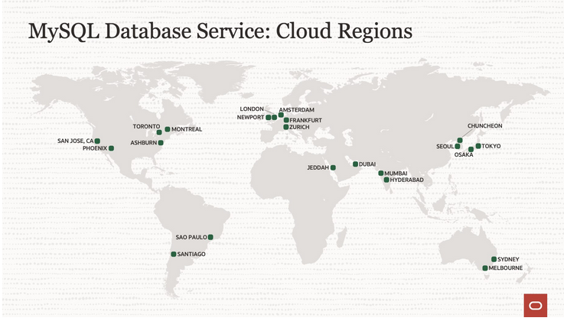
MySQL Database Service와 HeatWave는 모든 OCI 리전에서 이용 가능
Copyright © 2020, Oracle and/or its affiliates. All rights reserved.

